Slide 1


IoT Based Intelligent Dustbin Monitoring System
Presented by:
Jannatul Ferdaus
Roll: 17201117
Md. Habibullah Sheikh
Roll: 17201049
Hosain Mohammad Shafa khan
Roll: 17201020
Superviser
Shammi Akhtar
Assistant Professor
Department of CSE
University of Asia Pacific
External
Molla Rashied Hussein
Assistant Professor
Department of CSE
University of Asia Pacific
1

Slide 2

Content:
Introduction
Motivation
Problem Statement
Proposed system

Slide 3
Content(Cont...)
Components
Working Procedure
Comparison with others system
Experimental Results
Conclusion
Future Scope

Slide 4
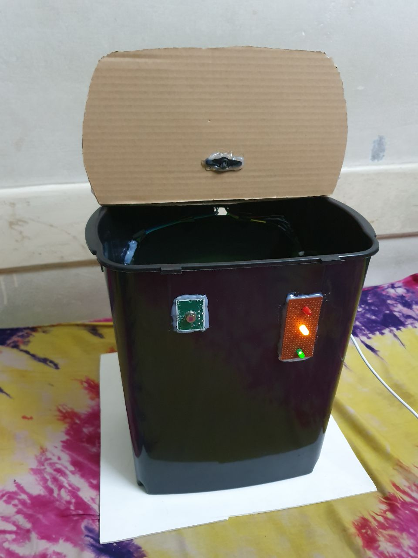
Introduction
Implementing smart solutions for garbage management
In effective ways to maintaining our environment clean and hygienic.
Preventing garbage bins being overfull.

Slide 5

Motivation
In cities avoid unhygienic & ugliness condition we come up a project called Intelligent Dustbin. Which is a GSM based waste and garbage collection bins overflow indicator systems for smart cities.

Slide 6
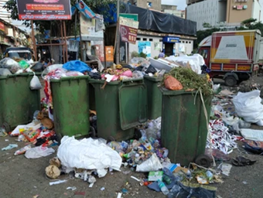
Problem Statement
Lack of proper systems for disposal and collections
Most of the dustbin is not a user-friendly
The cleaner does not accept the information about the overflowing garbage inside the dustbin.

Slide 7
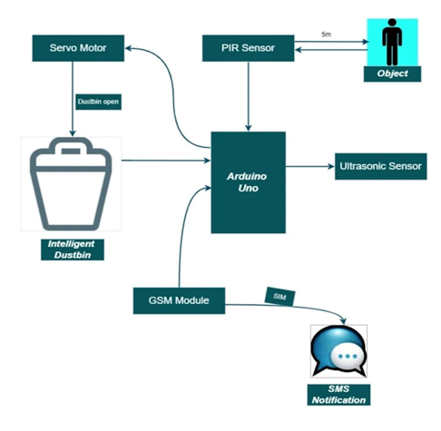
Proposed System
The proposed system will help to avoid the overflow of dustbin.
We will able to know the real-time information about the level of the dustbin.
When the dustbin becomes full it will send the message to the Garbage collector immediately.

Slide 8
Components
Arduino Uno Board
Ultrasonic Sensor
GSM Module
Servo Motor
PIR Sensor

Slide 9
Components(Cont...)
Garbage Container
Jumper Wires
LED
Breadboard
Software:
Arduino IDE

Slide 10
Working Procedure
Ultrasonic Sensor and Servo Motor are connected to the respective pins of Arduino.
PIR sensor detects an object like the hand.
If object is less than a predefined value, the servo motor gets turned on first.
The lid will open for a given time then it will automatically close.

Slide 11
Comparison with others system
Organized and user friendly.
Has social impact also can catch user attraction.
Automatically open and close of the lid of Intelligent dustbin.

Slide 12
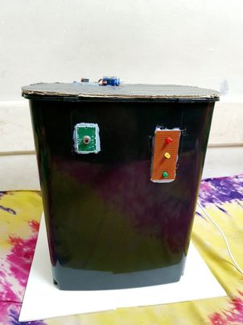
Experimental Results
Initially the dustbin lid is closed

Slide 13
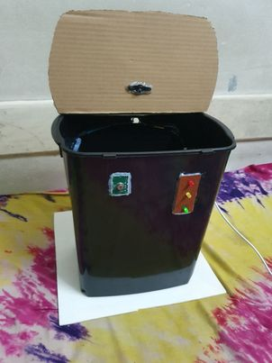
Dustbin lid is open & green led on

Slide 14
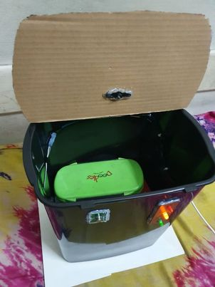
Lower half of dustbin is full & yellow led on

Slide 15
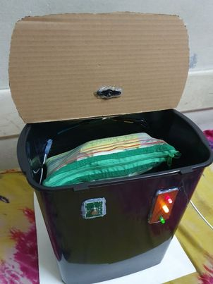
Dustbin is full & red led on

Slide 16
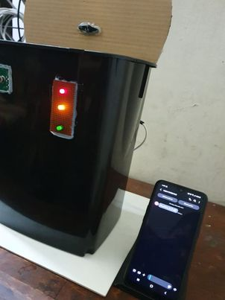
Dustbin is full & message has received

Slide 17
Conclusion
Garbage is generating at a higher pace but the garbage management system has not improved so here Intelligent dustbins are a better solution. IoT Based Intelligent Dustbin monitoring system can be very effective this model will digitalize and modernize the cities by applying the IoT-based Intelligent Dustbin monitoring system of Bangladesh.

Slide 18
Future work
So in the future, We can develop it better by adding more sensors that will help us to make this Intelligent dustbin auto moveable

Slide 19
Reference
1.http://dspace.bracu.ac.bd/xmlui/bitstream/handle/10361/8718/12321065%2c13101215%2c16141003%2c16341020_CSE.pdf?sequence=1&isAllowed=y
2. https://www.irjet.net/archives/V6/i5/IRJET-V6I51110.pdf
3. http://pep.ijieee.org.in/journal_pdf/11-132-1431516577101-104.pdf
4.https://www.semanticscholar.org/paper/SVASTHA%3A-An-effective-solid-waste-management-system-Issac-Akshai/408e9d707b38f45fbd1f42b7ae4a5b90c60c285d
5. http://www.ijaerd.com/papers/special_papers/NCSOSET14.pdf
6.http://www.ijesrt.com/issues%20pdf%20file/Archive-2018/May-2018/23.pdf
7.https://www.researchgate.net/publication/316700582_SMART_DUSTBIN_FOR_ECONOMIC_GROWTH
8.http://www.kscst.iisc.ernet.in/spp/39_series/SPP39S/01_Seminar%20Projects/068_39S_BE_0321.pdf
9. https://www.keyence.com/ss/products/sensor/sensorbasics/ultrasonic/info/#:~:text=As%2
0the%20name%20indicates%2C%20ultrasonic,between%20the%20emission%20and%2
0reception.
10. https://searchmobilecomputing.techtarget.com/definition/GSM
11. https://www.elprocus.com/servo-motor/
12. https://en.wikipedia.org/wiki/Passive_infrared_sensor#:~:text=A%20passive%20infrared
%20sensor%20(PIR,in%20PIR%2Dbased%20motion%20detectors.&text=They%20wor
k%20entirely%20by%20detecting,by%20or%20reflected%20from%20objects.
13. http://blog.sparkfuneducation.com/what-is-jumper-wire
14. https://en.wikipedia.org/wiki/Light-emitting_diode
15. https://www.researchgate.net/publication/343530056_SMART_DUSTBIN_USING_AR
DUINO
16. https://en.wikipedia.org/wiki/Breadboard

Slide 20


